Slide 1
SentinelWorks Presentation MA DPU Electric Grid Modernization Working Group
Customer-Facing Subcommittee Meeting
January 9, 2013

Slide 2
SentinelWorks What we do
Provider of cutting edge water, gas and electric software platform solutions for utilities and their customers (commercial/industrial & residential).
Helping utilities improve operational efficiency, manage consumption, save money and build a more sustainable future.
Located in Charleston, SC “Silicon Harbor”.

Slide 3
The SentinelWorks Team Who we are
Formed in 2009 to research, design and develop energy management software solutions – which would easily integrate with hardware from the leading manufacturers.
145 years of combined management experience (Fortune 100 companies and Capitol Hill).
Successful start-up background in healthcare and building trade industries.

Slide 4
The SentinelWorks Team What we have done
SentinelWorks team key accomplishments in systems management:
Artificial Heart Functionality
Retinal Scanning Security Systems
Secure Credit Card Processing
Healthcare Information Systems
Pharmacy Management Software & Dispensing Systems
Commercial and Residential Building Development Companies
Department of Defense Supply Chain Management Systems

Slide 5
SentinelWorks Solutions AMR & AMI
MISSION: Provide critical information to help utilities (REGARDLESS of their current system) improve operational efficiency, manage consumption, save money and build a more sustainable future.
Protect
Revenue
Conserve
Resources
Improve
Cost & Service
Manage
Assets

Slide 6
SentinelWorks Solutions AMR & AMI
Automatic meter reading (AMR) & Advanced metering infrastructure (AMI)
Energy management software provides utilities and their customers with dynamic and near real-time information to monitor and control their water, gas and electricity consumption across their entire service area.
Designed from the ground up to be a total meter-to-screen solution, including:
Metering and data management
Consumer engagement
Historic data repository
Integration with existing legacy systems
Application of Time Based Rate Programs

Slide 7
SentinelWorks
At-A-Glance
Billing &
Legacy Integration
Custom systems integration with billing, MDM, etc.
Utilize
SentinelWorks BrightStar
Solution
Long Term Storage
Advanced Analysis
Data Collection
Network Management
Access Current Data
Application of Time Based Rates
Store & Analyze
Collect & Manage
Digi Cloud
Digi hardware communicates with the meters / ERT & transmits the data
Collection
01/09/2013

Slide 8
SentinelWorks At-A-Glance
Consumer Engagement:
Relevant, timely information will empower
decisions about energy consumption and
offer value-added benefits to increase
customer satisfaction and positive utility
branding.
Data Management:
The SentinelWorks BrightStar Software Data Management Energy Performance System can rapidly process and aggregate large volumes of granular interval meter data efficiently and expeditiously.
Legacy System Integration:
SentinelWorks leverages your existing
AMR investment by working hand-in-hand with and supporting data from existing legacy infrastructure.
Historical Data Repository:
The BrightStar software system records
and tracks historical changes as well as
provides the power analysis of changes, trends and patterns.
Easily Implement Time Based Rate Programs:
Time-of-Use Pricing (TOU)
Real-Time Pricing (RTP)
Variable Peak Pricing (VPP)
Critical Peak Pricing (CPP)

Slide 9
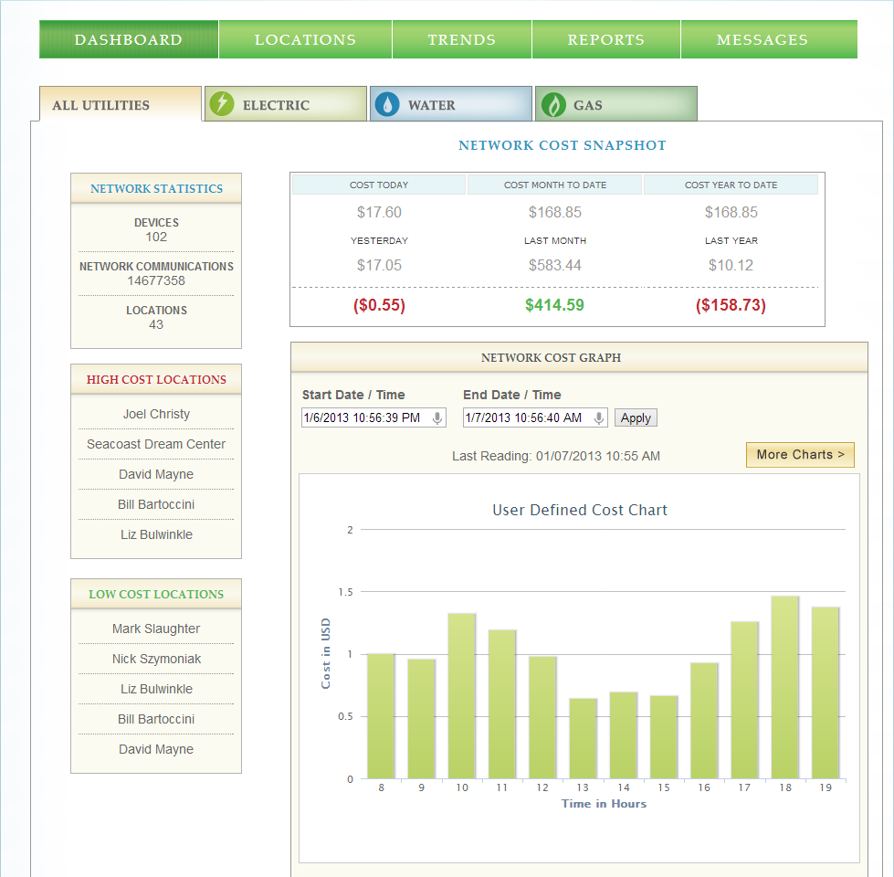
SentinelWorks Software Solutions for Utility
Utility Energy Management Solutions View

Slide 10
SentinelWorks Software Solutions for Utility Customers
Consumer Energy Management Solutions View

Slide 11
SentinelWorks Partners

Slide 12
SentinelWorks Conclusion
Provide critical information to help utilities (REGARDLESS of their current system) to improve operational efficiency, manage consumption, save money and build a more sustainable future.
Designed from the ground up to be a total meter-to-screen solution, including:
Metering and data management
Consumer engagement
Historic data repository
Integration with existing legacy systems
Implementation of Time Based Rate Programs
Partner Today. . .Partner Tomorrow. . .

Slide 13
SentinelWorks Thank you for your time
Questions?

